Slide 1
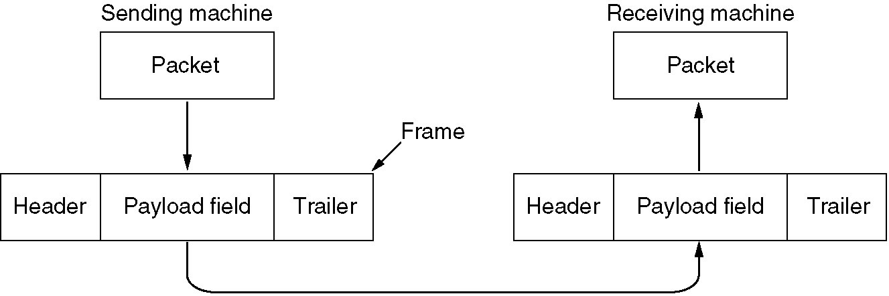
Frames
Received from network layer
Packet encapsulation for transmission

Slide 2
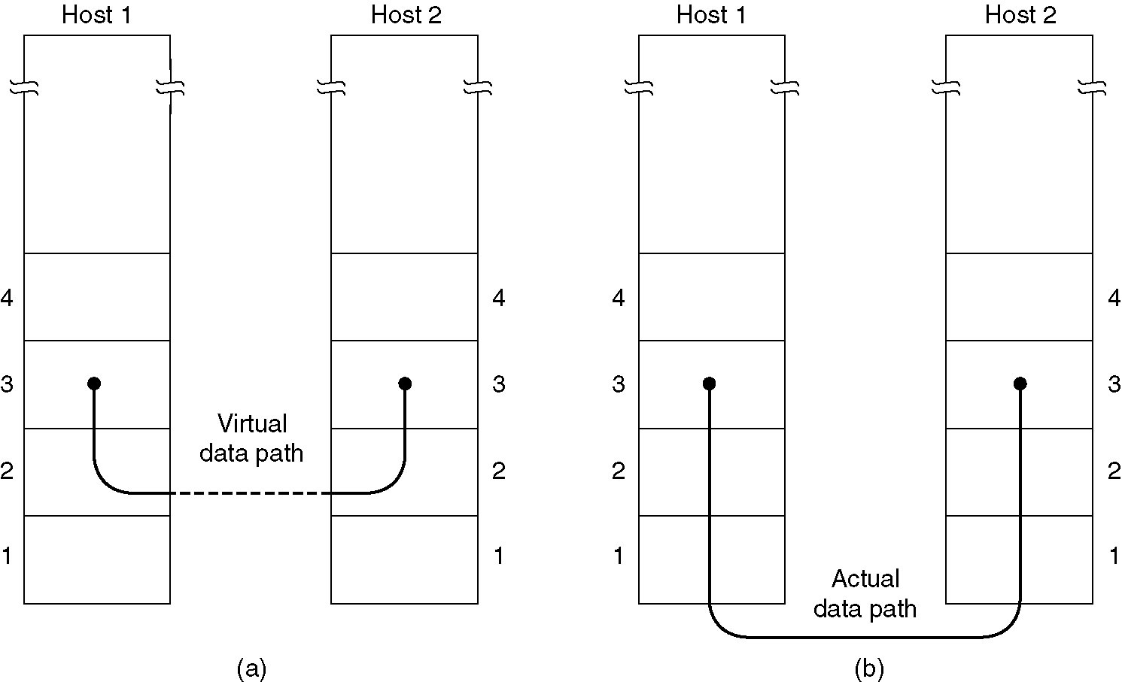
Services Provided to Network Layer
Primary service is transferring data from network layer on source machine to network layer on destination
(a) Virtual communication
(b) Actual communication

Slide 3
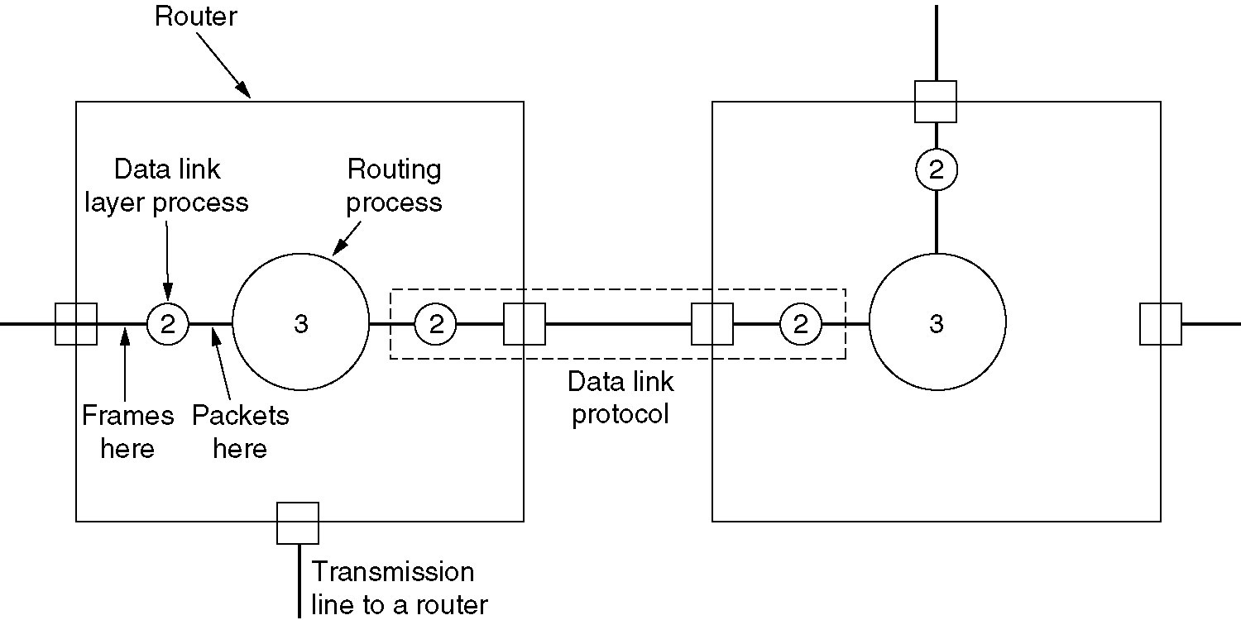
WAN Subnet Example
Placement of the data link protocol

Slide 4
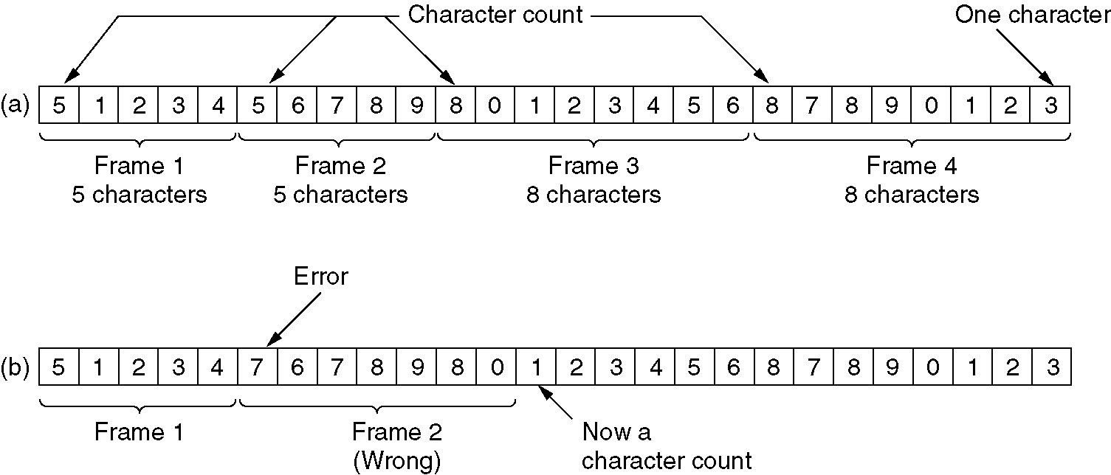
Character Count
Header field specifies number of characters in frame
Destination data link layer uses character count to determine end of frame
Errors make frame tracking difficult
Rarely used
A character stream.
(a) Without errors.
(b) With one error.

Slide 5
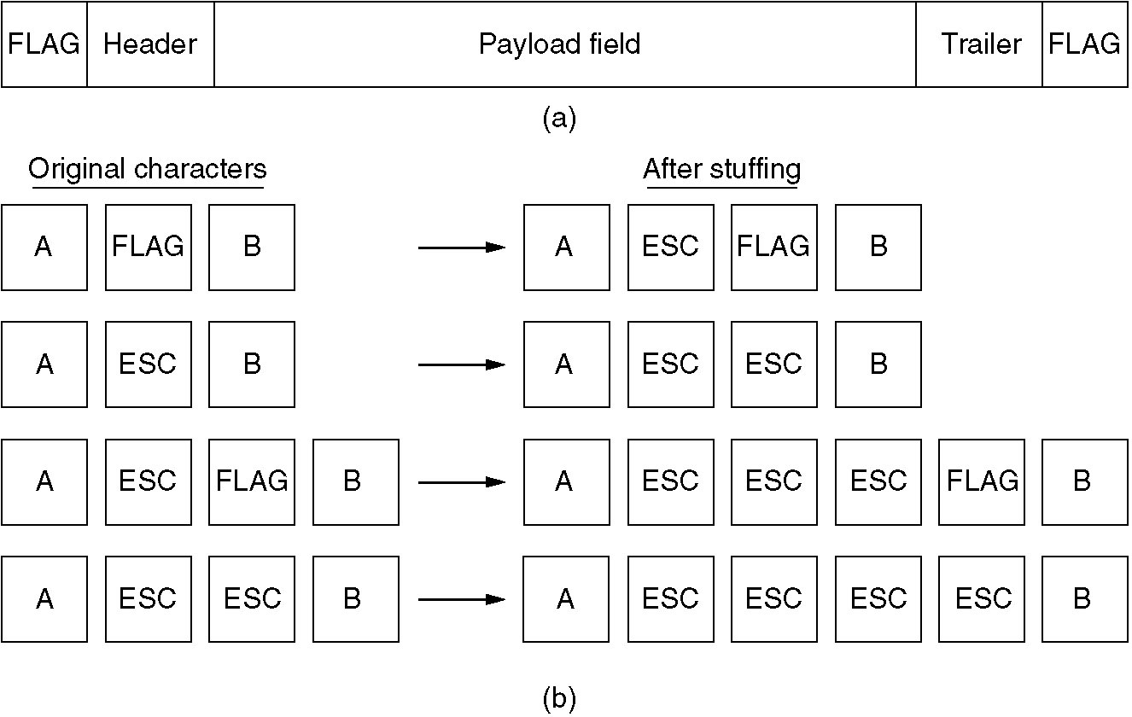
Flag Bytes with Byte Stuffing
(a) A frame delimited by flag bytes
(b) Four examples of byte sequences before and after stuffing

Slide 6
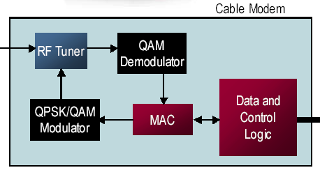
Cable Modem Example

